Slide 1
The product of Smart Data Genie
Data Science Job Hunt
Accelerate you job search!

Slide 2
Meet the Team Members
Jyoti Bhandari - Team Leader
- Data Acquisition
Model Development
Model Deployment
Abiral Shrestha
-Storytelling and Data Visualization
-Making Data Dashboard
- Data Acquisition
Kamidi Madhuri - Data Preprocessing
- Report Development

Slide 3
THE PROBLEMS
Unaware about skills & opportunities
Uncertainty regarding salaries and skills
What is the job satisfaction level?
We are often unaware of the job opportunities in Data Science.
What are the skills required and expectation from each company?
Wouldn’t it be great if there was a platform that could predict salaries and skills required for different companies?
Also, who wouldn't want to know whether they will be satisfied at their future company?
01
02
03

Slide 4
DATA SCIENCE JOB HUNT PROVIDES THE FOLLOWING SOLUTIONS:
An Interactive Dashboard That Can Show Data Science Job Opportunities And Skill Requirements Through Us
Prediction Of Salaries Of Different Data Science Jobs Based On Your Skills Using Various Machine Learning Models
Predict Your Satisfaction Level For The Different Available Jobs And Companies To Find The Best Match
01
02
03

Slide 5
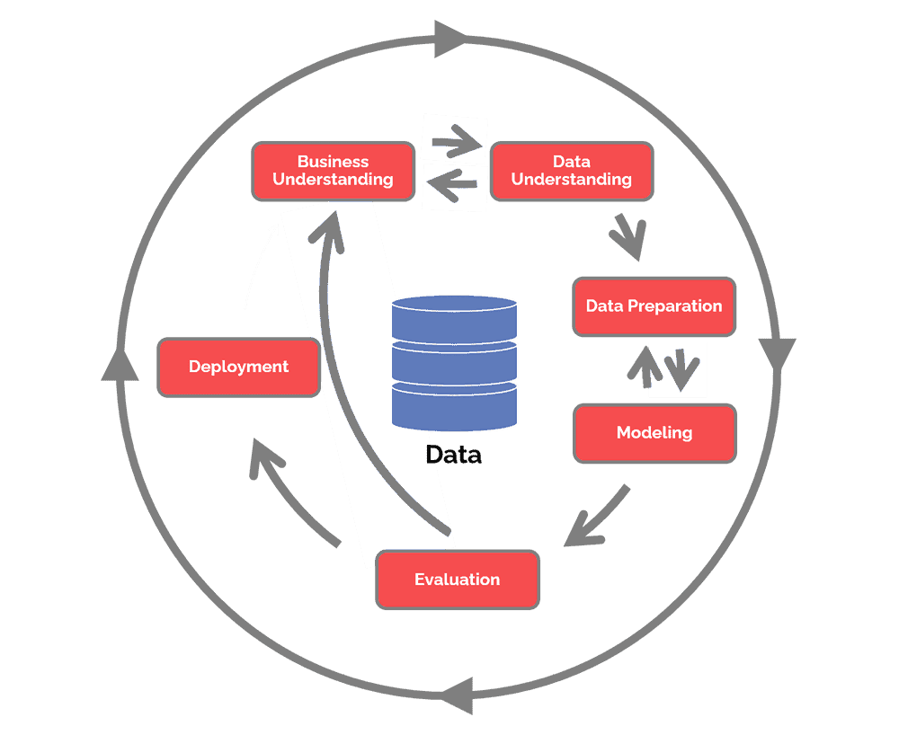
Business model: CRISP-DM Methodology
Business understanding – What does the business need?
Data understanding – What data do we have / need? Is it clean?
Data preparation – How do we organize the data for modeling?
Modeling – What modeling techniques should we apply?
Evaluation – Which model best meets the business objectives?
Deployment – How do stakeholders access the results?

Slide 6


Business Understanding
This phase is to determine the business objective and requirements.
Our business objective is to provide a platform for Data Science job seekers to delve deeper into the US job market and determine the companies where they would have a higher job satisfaction.

Slide 7
Data Understanding
In this phase, we identify, collect, and analyze the data sets that can help us accomplish our project goals.
Two datasets : First one contains Data Science job details (The dataset is scraped from the Glassdoor website) and another data set has HR data collection of employees with satisfaction level.
Both datasets will be acquired from Kaggle.

Slide 8

Data Preparations
Check for NULL and missing values
Scale the Data
Transform the Data
Encoding the data to categorical variables

Slide 9
Modeling
Use different Machine Learning Algorithms such as Random Forest Regression, Linear Regression, Logistic Regression, Neural Network, and choose the best model.
Use Python, Dash, and Plotly to develop dashboards.

Slide 10

Evaluation
For the evaluation purpose we will use metrics like Mean Absolute Error(MAE), Root Mean Square Error(RMSE), Mean Square Error(MSE) and the R2 score or the accuracy score from the Models to choose the best model for the data.

Slide 11

Deployment
Deploy the model to AWS(Amazon Web Services)
Fig. Dash Plotly and AWS Elastic Beanstalk

Slide 12
Why We are Better?
Made For Data Science With Data Science
Dashboards For Easy Job Tracking And Analysis
Skills Development And Job Satisfaction Prediction
Landing The Perfect Data Science Job

Slide 13
Future Enhancements
What enhancements we want in the future…..
Job seekers can apply through the webapp
Employers partnering with us to advertise them
Interview help for the job seekers

Slide 14

Product Timeline & Roadmap
04
Model Testing and Technical Report Writing
Finish the final testing and technical report
03
Model Deployment on AWS
02
Data Modeling and Evaluation
Deploy the dashboard and model on AWS using dash, plotly
Data Preparation And Exploratory Data Analysis
Milestones
Make data models, train and test model and evaluate the models to select the best one
01
Make data dashboards and do exploratory data analysis
W4
W1
W2
Time
W4
W1
W2
W3
W1
W4
October
November
November
December

Slide 15


Any Queries?
Thank You!!!

